Slide 1

OpenShift Container Platform 3.11 to 4.7
Application Migration

Slide 2

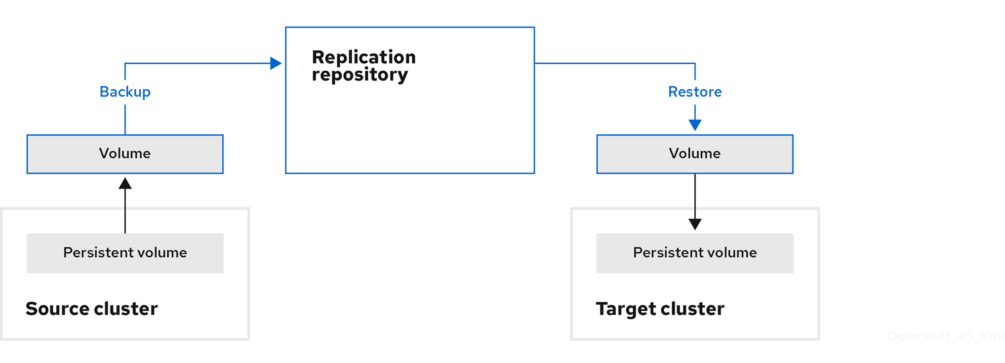

Slide 3
MigCluster CR: Defines a host, local, or remote cluster The migration-controller pod runs on the host cluster.
Secret CR: Contains credentials for a remote cluster or storage
MigStorage CR: Defines a replication repository Different storage providers require different parameters in the MigStorage CR manifest.
MigPlan CR: Defines a migration plan
MigMigration CR: Performs a migration defined in an associated MigPlan You can create multiple MigMigration CRs for a single MigPlan CR for the following purposes

Slide 4
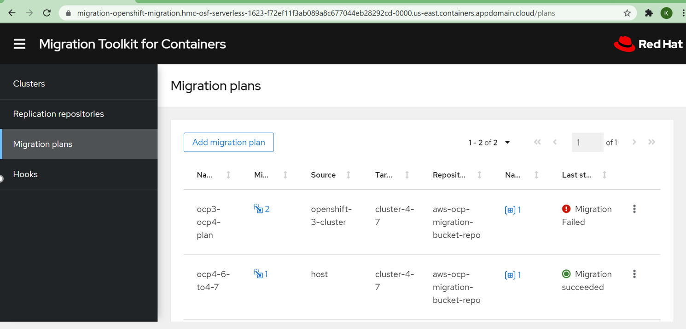

Slide 5
